Slide 1

CVR COLLEGE OF ENGINEERING DEPARTMENT OF COMPUTER SCIENCE AND ENGINEERING
A Mini Project Seminar-I
on
Securing the Web through the analysis of Phishing URL using Machine Learning Algorithms
by
P. Sowmith Reddy (20B81A05P0)
Balguri Vaishnavi (20B81A05V5)
Under guidance of
Ms. Sumalatha
Assistant Professor
ET(CSE-CS)

Slide 2
ABSTRACT
The internet is full of security risks. Antivirus and firewalls defend, but phishing exploits user vulnerabilities. This project aims to enhance internet security by proposing a machine learning-based phishing detection system. It utilizes algorithms like Decision Tree, Support Vector Machine, Gradient Boosting Classifier, K-Nearest Neighbors, Random Forest, and Logistic Regression to analyze URLs. The focus is on improving detection accuracy using performance metrics such as accuracy, precision, recall and F1-score. A user-friendly graphical interface will be developed, integrating the most accurate model for easy identification of phishing and legitimate URLs.

Slide 3
MOTIVATION
The motivation behind phishing detection lies in the pursuit of strengthening cybersecurity by mitigating the risks posed by deceptive online practices.
Phishing detection aims to protect sensitive information, like user credentials and financial details, by identifying and preventing attacks, ensuring they don't end up in the hands of malicious actors.
Despite the effectiveness of antivirus and firewall systems, skilled attackers exploit user weaknesses through phishing attempts with deceptive webpages.
To tackle this challenge, the project proposes a machine learning-based approach, employing different algorithms to analyze URLs and create a robust defense mechanism.

Slide 4
LITERATURE REVIEW
EXISTING SYSTEMS
When dealing with phishing websites, there are two main approaches:
1. List Based Phishing Detection Systems:
Phishing detection systems use whitelists for safe sites (granting access if the URL is whitelisted) and blacklists for phishing sites (denying access if the URL is blacklisted).
Whitelist allows access based on inclusion, while blacklist denies based on exclusion (Y. Le, 2018).
2. Visual Similarity-Based Phishing Detection Systems:
Visual similarity-based phishing detection systems assess web pages using server-side image processing techniques to compare features of phishing and non-phishing sites.
They play a crucial role in identifying subtle visual distinctions between fake and legitimate websites (Xiaoyue, 2016).

Slide 5
LITERATURE REVIEW
LIMITATIONS OF EXISTING SYSTEMS
The mentioned approaches, while effective, have certain limitations:
Limitations of List Based Phishing Detection Systems:
Vulnerability to URL Modifications.
Ineffectiveness against Zero-Day Attacks.
Limitations of Visual Similarity-Based Phishing Detection Systems:
Difficulty in accurately identifying subtle visual differences.
Potential for false positives or negatives.
Challenges with complex web page designs and adaptive phishing techniques.

Slide 6
PROBLEM STATEMENT
Phishing attacks pose a serious threat, exploiting evolving tactics to compromise data and cause financial losses.
Current cybersecurity measures fall short, necessitating advanced detection systems that leverage cutting-edge technologies, such as machine learning models, to effectively identify and mitigate phishing threats.

Slide 7
PROPOSED WORK
This project aims to enhance internet security by creating a comprehensive phishing detection system by employing various machine learning models.
After rigorous testing, the model with the highest accuracy is integrated into a user-friendly GUI, allowing individuals to predict whether a given URL is phishing or legitimate, accompanied by a confidence percentage.
Addressing limitations in traditional methods like List Based Phishing Detection Systems and Visual Similarity-Based Phishing Detection Systems, our approach, with improved accuracy and an intuitive interface, outperforms existing models.

Slide 8
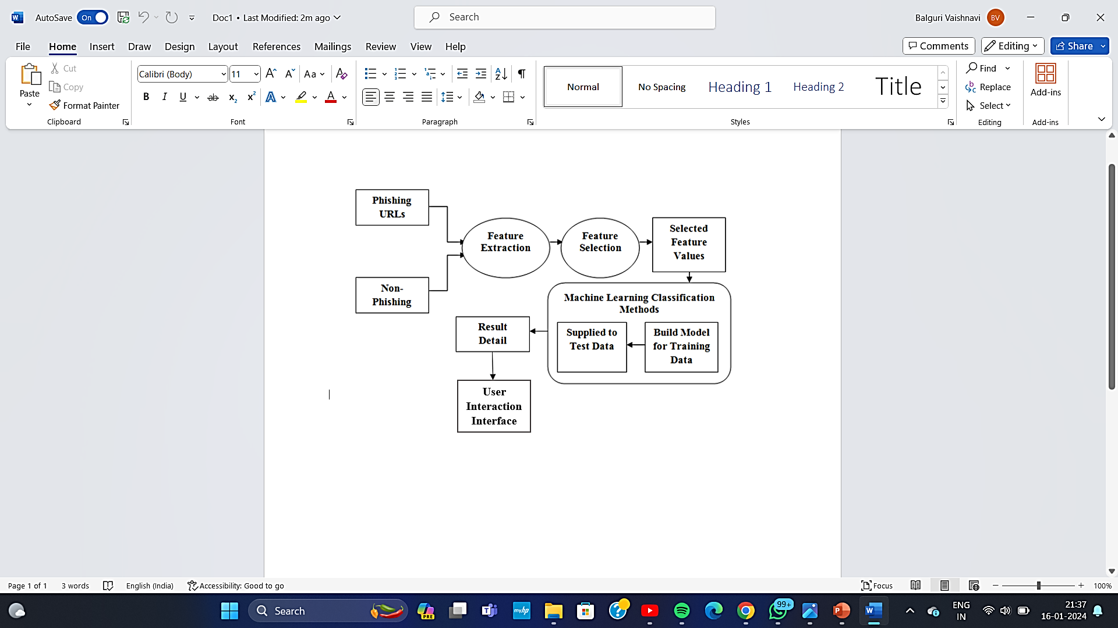
METHODOLOGY OF THE PROPOSED WORK

Slide 9
FUNCTIONAL REQUIREMENTS
Functional requirements describe the specific behaviour and functionalities that a system must perform to meet the user’s needs.
Functional requirements of our System:
Data Collection
Feature Extraction
Machine Learning Models
User-Interface
Security Measure

Slide 10
NON-FUNCTIONAL REQUIREMENTS
Non- Functional requirements specify the qualities and characteristics that are essential for the effective operation of a system, focusing on aspects such as performance, usability, reliability and security.
Non-Functional requirements of our System:
Performance
Security
Reliability
Usability
Compatibility

Slide 11
SOFTWARE REQUIREMENTS
Operating System - Windows, MacOS or Linux
Programming Language - Python 3.10.9
Execution Environment - Jupyter Notebook or Visual Studio Code
Web Framework - Flask or Tkinter
Machine Learning Libraries - Scikit-Learn, Pandas, Numpy

Slide 12
HARDWARE REQUIREMENTS
RAM - 8 GB or above
Processor - Intel core i5 with 11th gen or above
Storage - 256 GB SSD or above
Stable network connection

Slide 13
DATASET REQUIREMENT
Phishing website Detector dataset is used from Phishing website Detector | Kaggle.
It contains 11054 samples.
Each sample has 30 parameters and a class label identifying it as a phishing website or not (1 or -1).

Slide 14
PLAN OF ACTION
Project Initiation
Gathering Data
Identifying various data sources
Collect data
Integrate the data obtained from different sources
Data Preprocessing
Machine Learning model Development
Documentation
Testing and Validation
GUI Development
User Interface Design
Integration with ML model
Train Model
Utilizing Machine Learning Algorithms
Improving Performance

Slide 15
REFERENCES
[1] Y. Daeef, R. B. Ahmad, Y. Yacob and N. Y. Phing, ”Wide scope and fast websites phishing detection using URLs lexical features,” 2016 3rd International Conference on Electronic Design(ICED), Phuket,2016, pp. 410-415. doi:10.1109/ICED.2016.7804679
[2] N. Sanglerdsinlapachai and A. Rungsawang, ”Using Domain Toppage Similarity FeatureinMachineLearning BasedWebPhishingDetection,”2010ThirdInternational
[3] L. Wenyin, G. Huang, L. Xiaoyue, Z. Min, and X. Deng, “Detection of phishing webpages based on visual similarity,” Special interest tracks and posters of the 14th international conference on World Wide Web - WWW 05, pp. 1060-1061, 2016.
[4] Y. Cao, W. Han, and Y. Le, “Anti-phishing based on automated individual white-list,” Proceedings of the 4th ACM workshop on Digital identity management - DIM 08, pp. 51–60, 2018.

Slide 16

THANK YOU

